Slide 1
The Nucleus’ Physical Role in Collective Cell Migration
Presented By: Brady Hine
Notes:
Hi, I’m Brady and the specific problem I’m trying to address this year in MECH 498 is how mechanical properties of the cell nucleus affect the process of collective cell migration.

Slide 2
Recap
Problem
Significance
Collective migration
Nucleus mechanical impacts
Scratch wound assay
Cell repopulation
Wound healing
Developmental tissues
Notes:
To recap, last time we discussed the process of collective cell migration and how this may be influenced mechanical properties of the cell nucleus. To investigate these effects, a scratch wound assay model is being used where a layer of cells is cultured, and a scratch is applied. Time lapse imaging of the healing process is then used to quantify migration parameters such as speed and wound closure potential. The importance of this research comes from the need for a deeper understanding of collective cell migration as it’s necessary for cell repopulation in tissue engineering, wound healing, and formation of developmental tissues among other processes.

Slide 3
Specific Aims
Aim #1
Establish a scratch wound assay of cell migration using NIH-3T3 cells
Migration quantification and validation
Y27 (myosin contraction inhibition) and/or cyto-D (actin inhibition)
Aim #2
Observe how changes to nuclear mechanics affect migration parameters
Modify stiffness and chromatin remodeling
Trichostatin A (softening by HDAC inhibition) and GSK126 (stopping chromatin remodeling)
Notes:
That leads me to the specific aims for this project. The first of which being to establish the scratch wound assay that will be used to conduct these experiments. This aim will also include determining methods for quantifying migration as well as validating the setup by using some migration inhibitors. The second aim for the project will involve observing how changes to nuclear mechanical factors impacts the quantified migration parameters. Modifying the nucleus will be done by applying some drugs that will affect chromatin remodeling and nuclear stiffness.

Slide 4
Specific Aims
Aim #3
Perform live imaging of the cytoskeleton and nucleus at high resolution to quantify a strain map in the cell monolayer.
NucBlue (nucleus) and Lifeact (actin)
Future work
Investigate interactions between nuclear mechanics with substrate mechanics and cell crowding
Notes:
The last specific aim for this project will involve using live staining and imaging of the nucleus and actin cytoskeleton during the scratch wound assay. This data will then be used to develop a strain map at the cell monolayer level providing detailed mechanical insight into the migration process. If these aims are successfully met, it’d help lay groundwork for looking into interactions of nuclear mechanics with cell crowding effects and substrate mechanics.

Slide 5
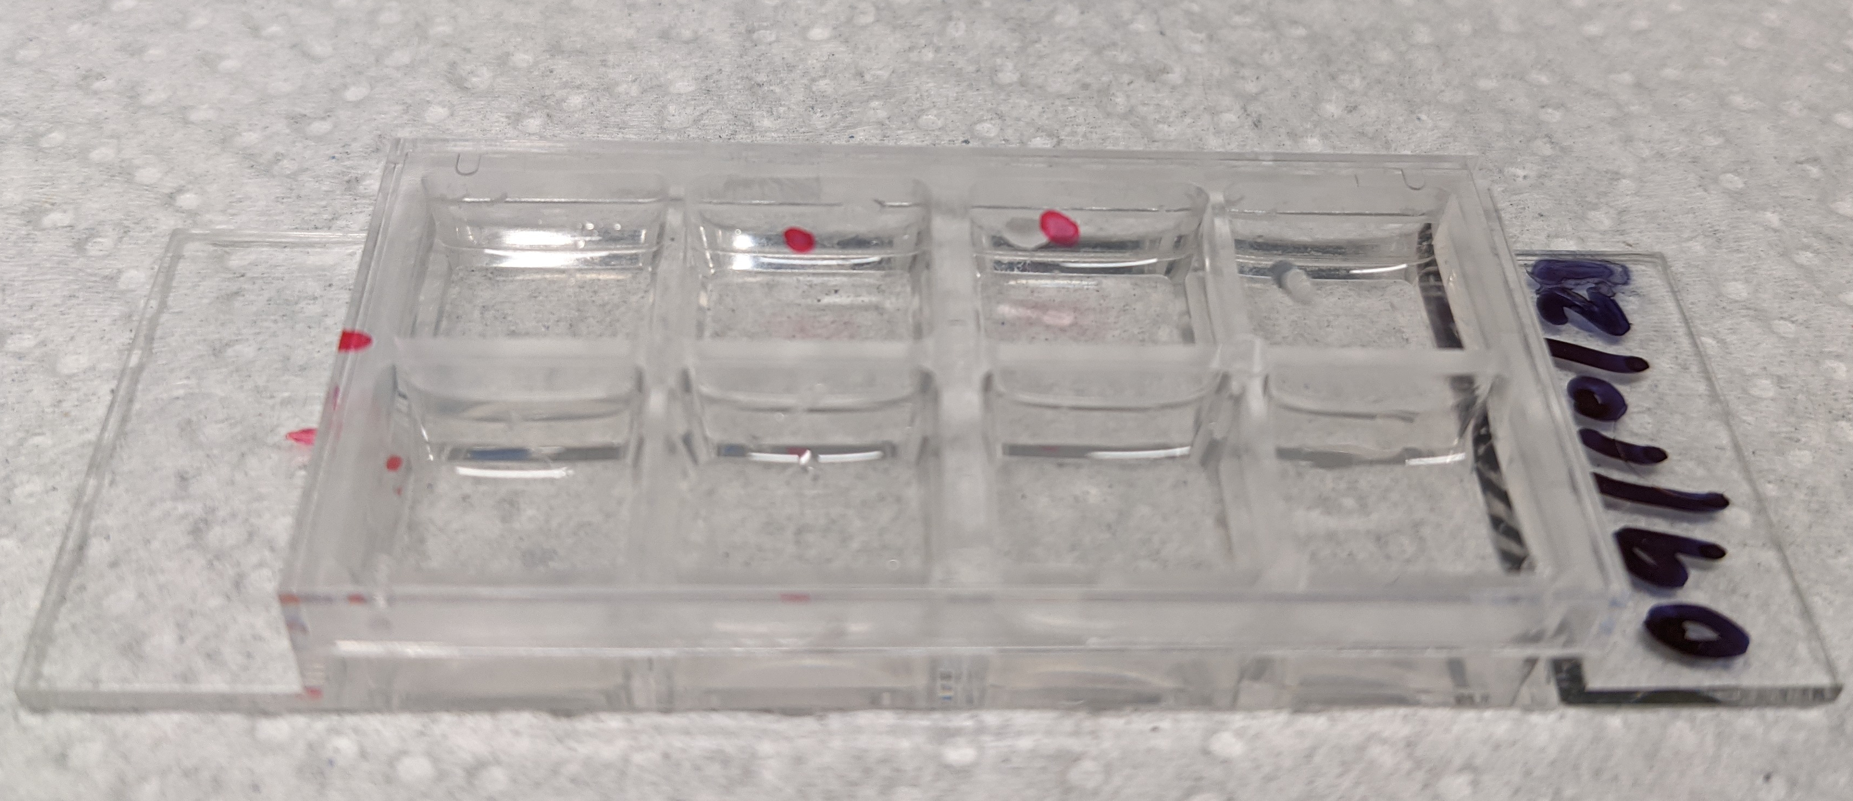
Establishing Assay
Cell culture and scratch application
Confluence timing (1-3 days)
Scratch methodology
Assay imaging
Imaging timeframe
Cell maintenance
Notes:
Most of the preliminary work done to this point has been spent establishing the scratch wound assay. This began with determining a proper time for culturing the cells in an 8-well plate like this until they were confluent. The image shown here was one of our initial attempts at performing the scratch which was a bit crude along the edges had a bit of debris present which was not optimal. So next it was important to establish a repeatable method for making scratches on the monolayer with as clean edges as possible which was done using a pipette tip and straight edge as a guide. The optimal timeframe for imaging after scratching is still being determined as initial imaging was taken before observable migration had occurred or after the wound had fully closed. The process of imaging the cells involved a regulated chamber for temperature and CO2 levels and required adding medium during non-imaging intervals to stop the wells from drying out.

Slide 6
Establishing Assay
Cell staining
Fixed nucleus (DAPI) and actin (phalloidin)
Live nucleus (NucBlue)
Live stain timing
Image Processing
Cell morphology
Cell tracking
Wound parameterization
Notes:
Work has also been done establishing cell staining methods for actin and the nucleus in both live and fixed cells. Staining of fixed cells allowed us to observe cell morphology and density in the wound more clearly at a given time point. In this image you can see an actin tail on this cell as well to get an idea of where the cell has moved from. Different live and fixed stains are required due to live stains needing to small enough to fit through pores in live cells. With live staining, we have seen that applying the live stain too early can have negative impacts on the wound healing process as well as the stains used being photosensitive requires a specific time window to apply the live stains. The most current work is focusing on image processing specifically using automated cell tracking. This will allow us to quantify parameters like speed and persistence of the migrating cells while wound parameters like closure percentage and closure potential will be determined by tracking leading edges of cells closing the wound.

Slide 7
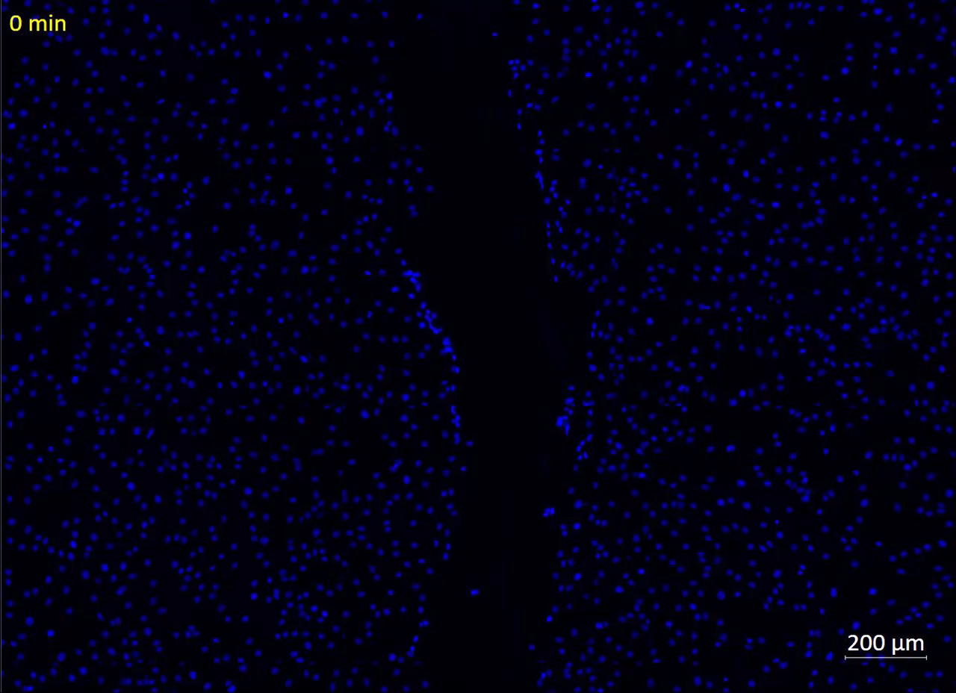
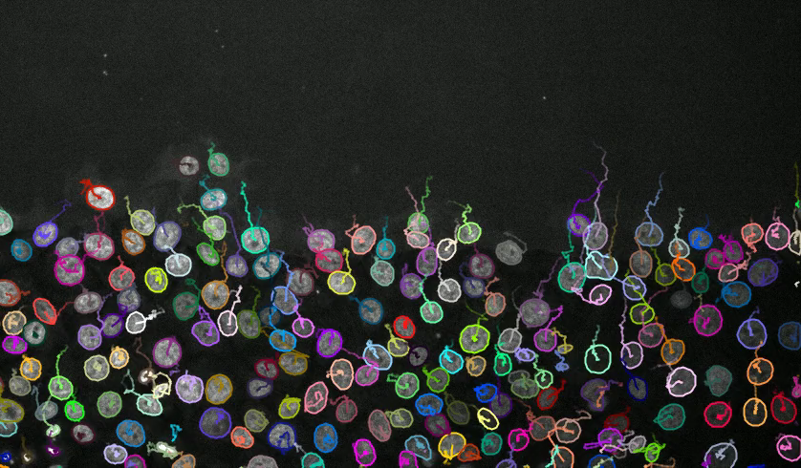
Cell Tracking
Ershov, D., Phan, M.-S., Pylvänäinen, J. W., Rigaud, S. U., Le Blanc, L., Charles-Orszag, A., … Tinevez, J.-Y. (2021, September 3). Bringing TrackMate into the era of machine-learning and deep-learning. Cold Spring Harbor Laboratory. doi:10.1101/2021.09.03.458852
Notes:
The video on the left here was one of our initial tests with live stained images where we realized a staining window was needed. Thus, there isn’t much migration observed in this data set but it serves to visualize how we plan to apply the automated cell tracking by staining the cell nucleus. On the right is a video of cells being individually tracked in a large cluster using an open-source plugin for ImageJ. As you can see, a path is traced for each distinct cell over time measuring distances travelled for each cell. From here movement speed can be calculated as well as persistence which is a measure of how straight these cell paths are. This week actually we are collecting new live stained data which we plan to apply this automated tracking system to at the end of the week.

Slide 8
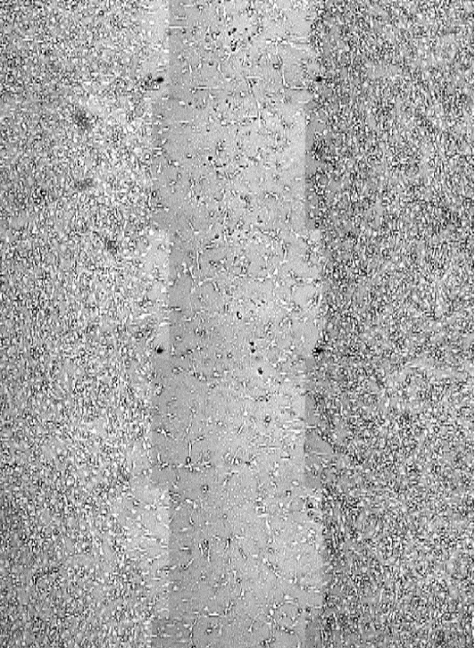
Supplementary Video
Migration imaging in brightfield view

